Slide 1




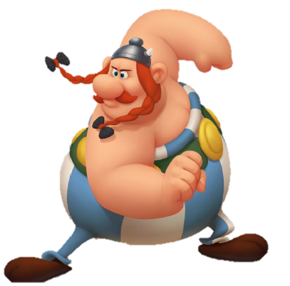
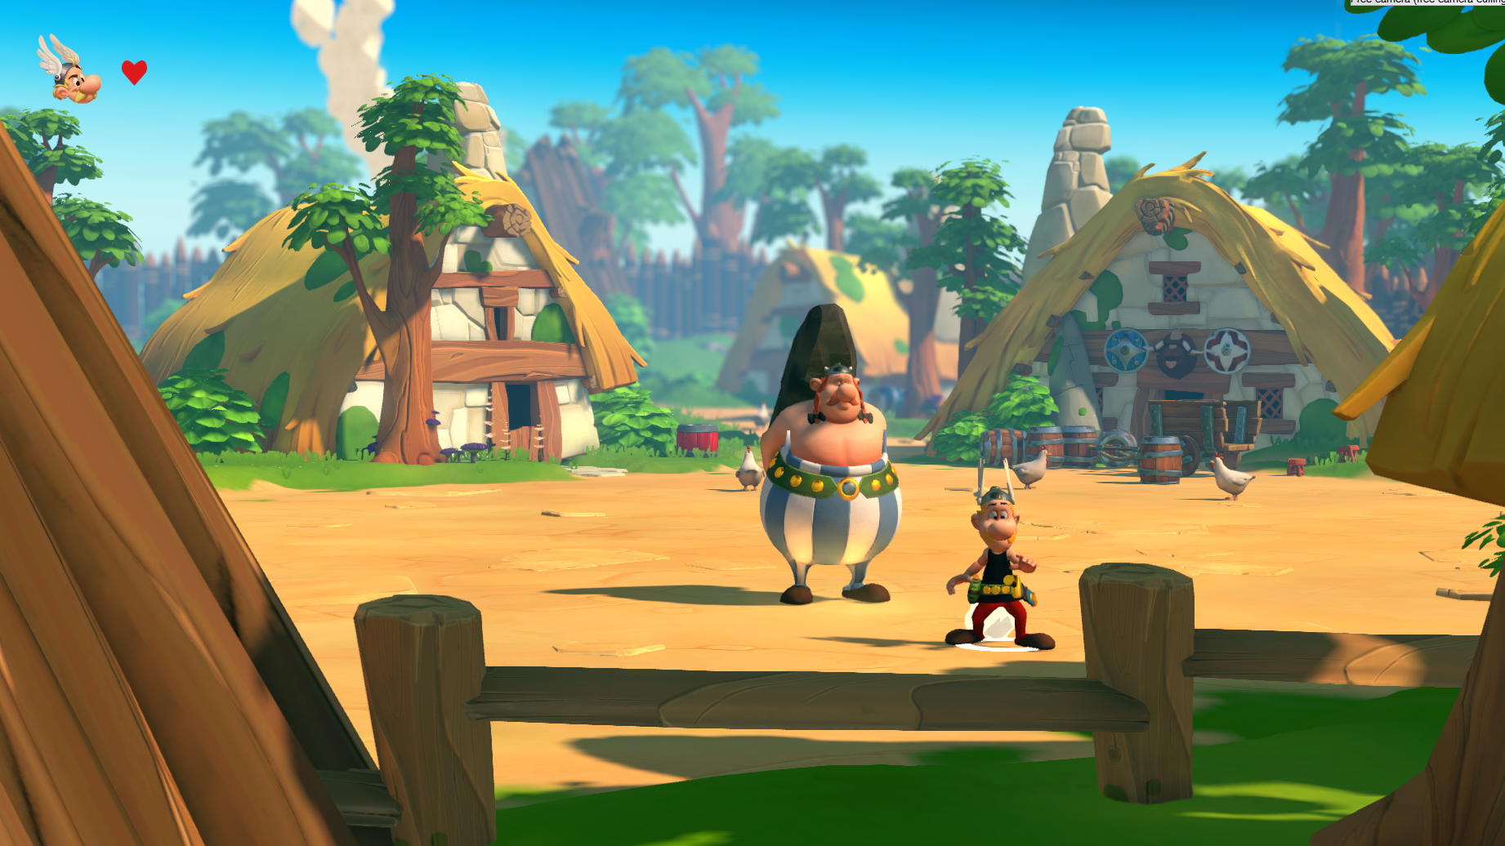
MARKETING PRESENTATION
Microids – Confidential Document

Slide 2
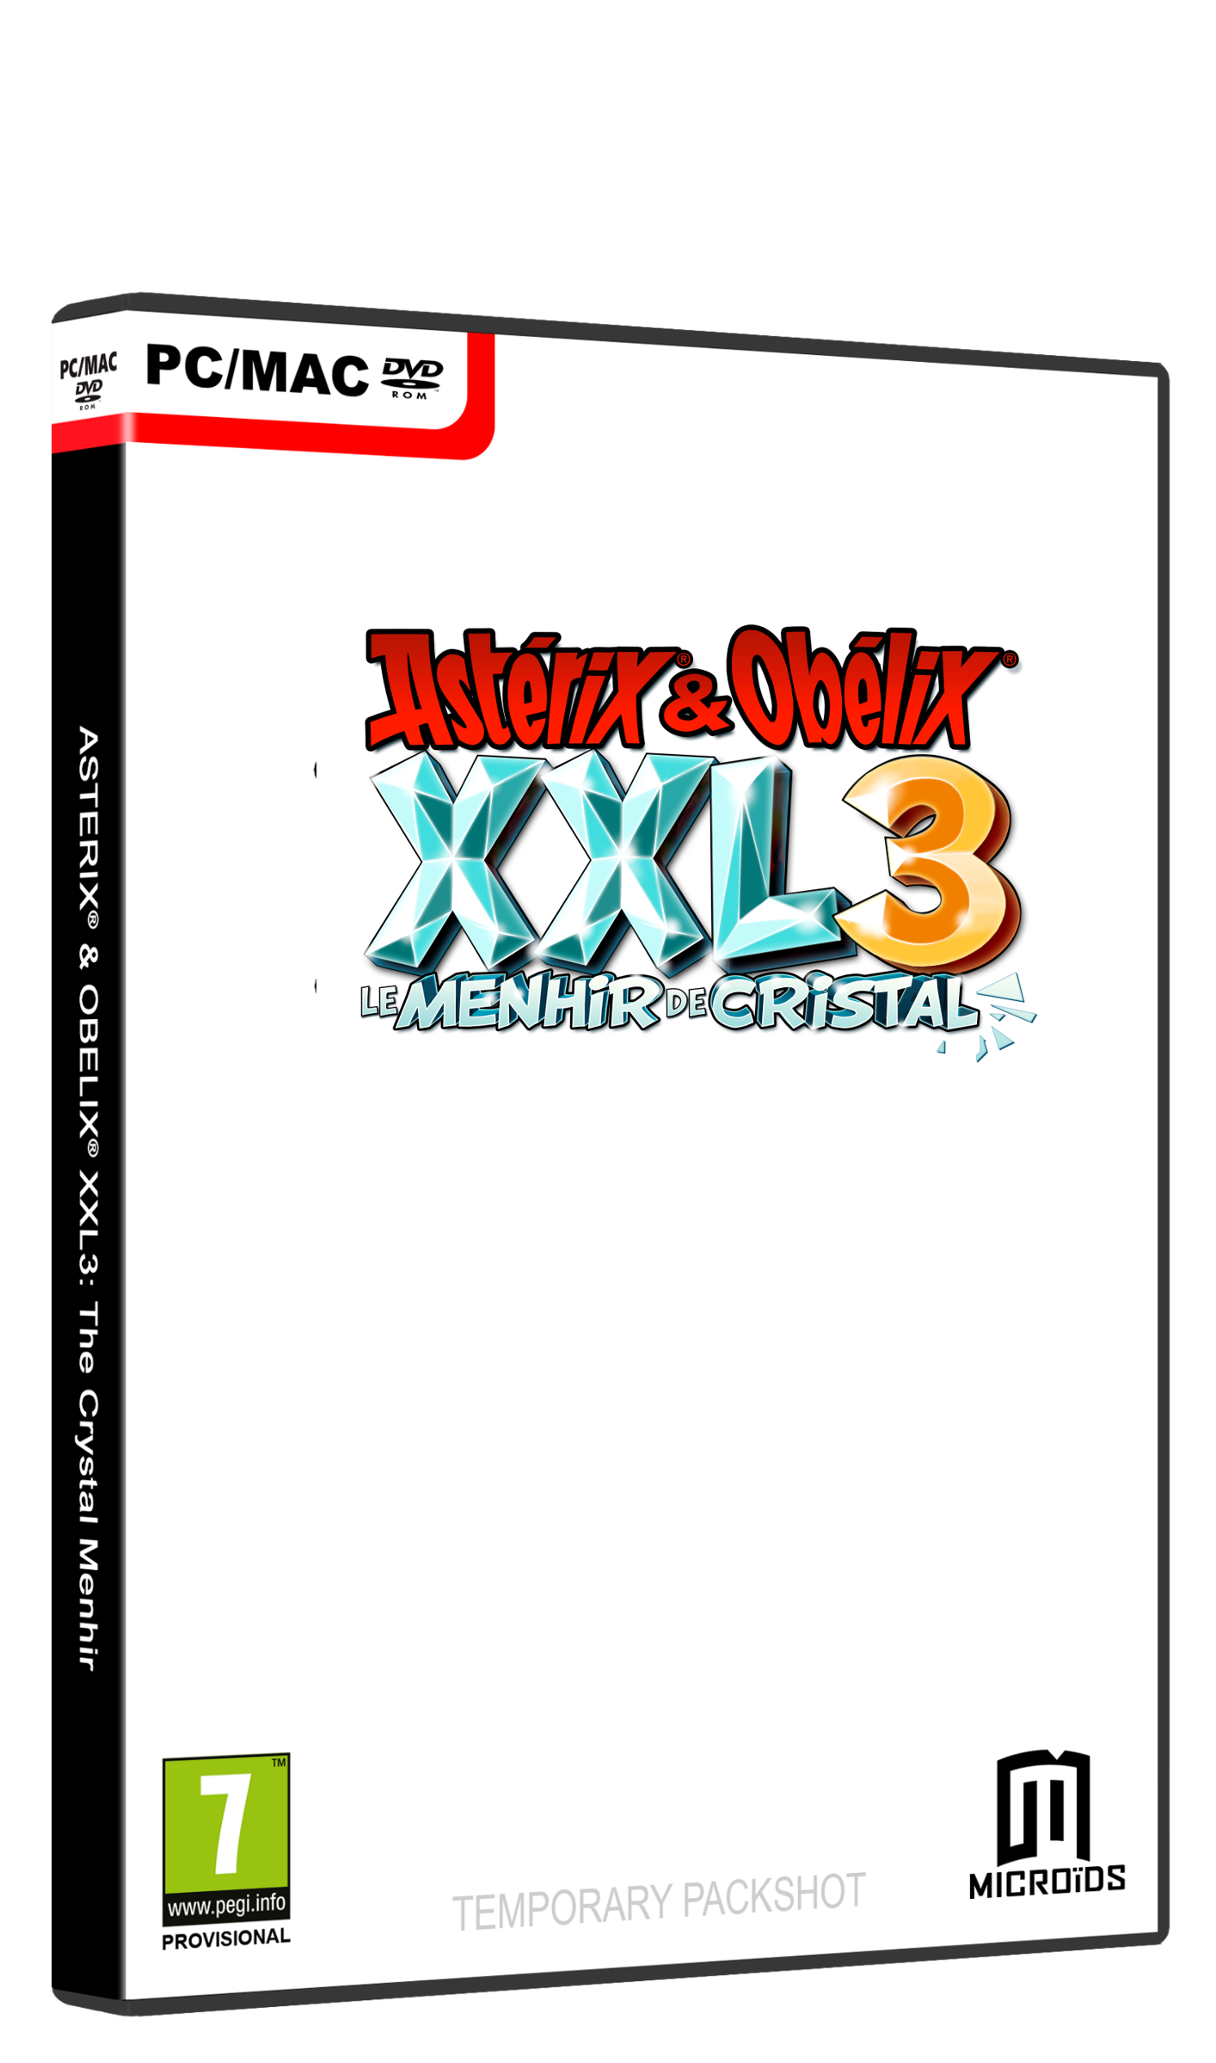
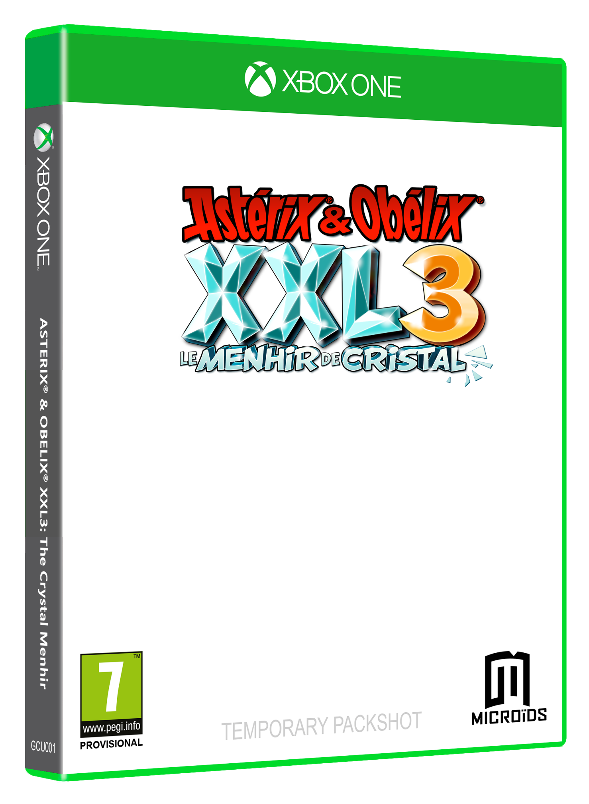


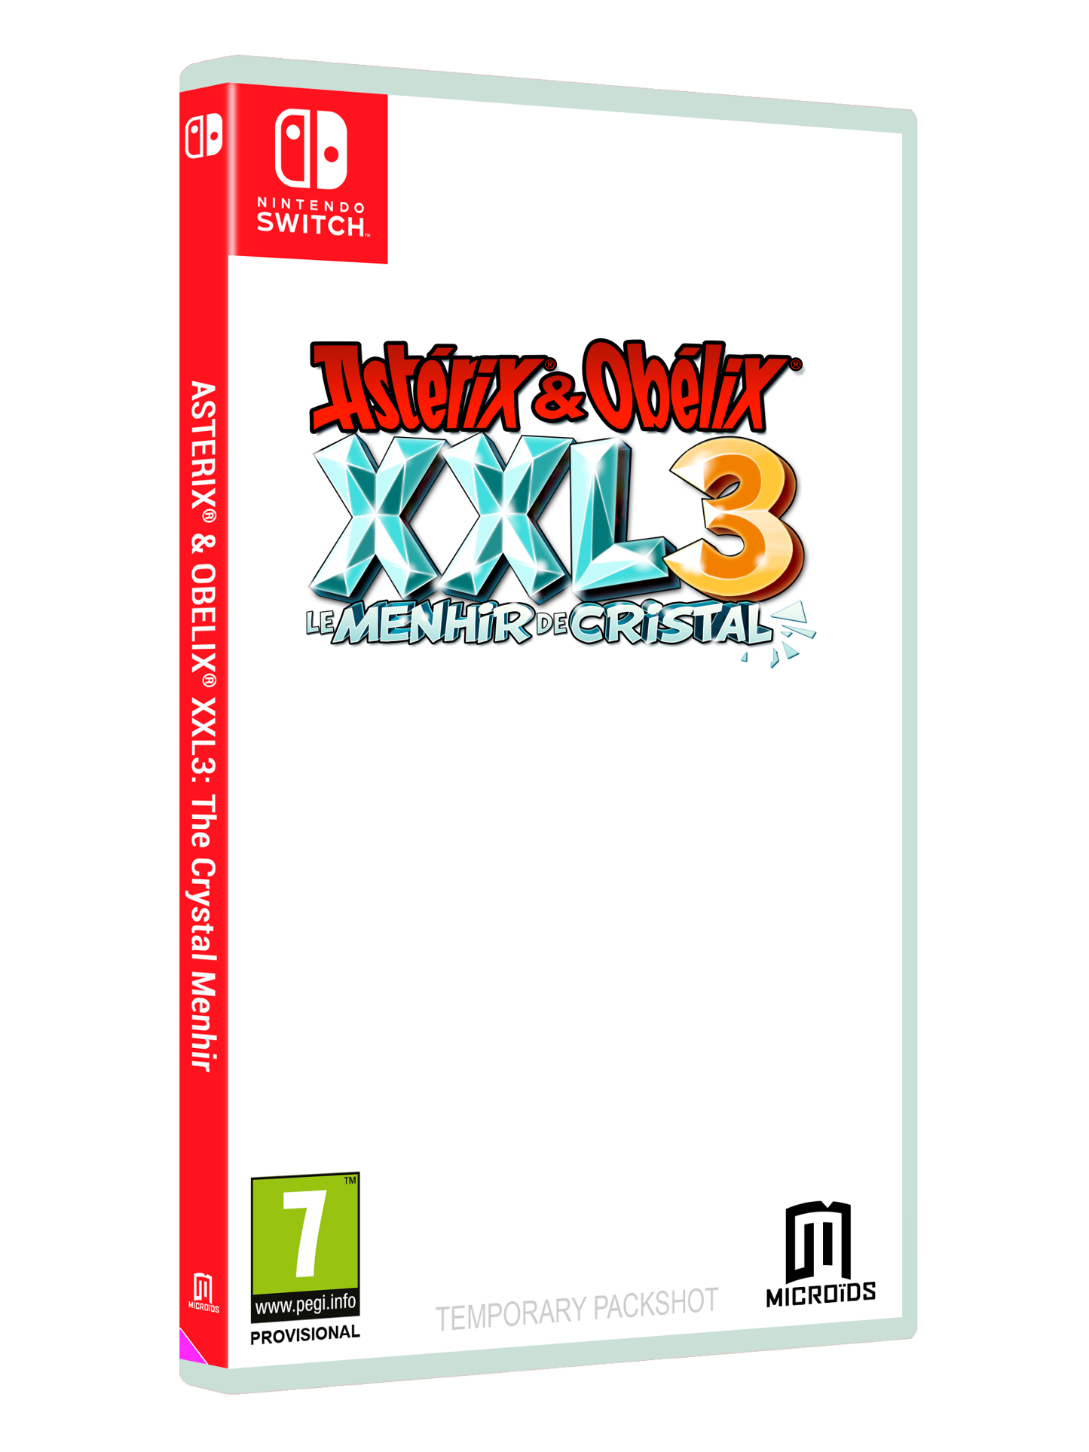







GAME INFO
TITLE Asterix & Obelix XXL 3: The Crystal Menhir
GENRE Action/ Adventure - Cooperation
PLATFORMS SWITCH, PS4, XONE, PC/MAC
RELEASE Christmas 2019
SRP Consoles 49,99€ / PC 39,99€
DEVELOPERS OSOME STUDIO
PUBLISHER Microïds
AUDIO
TEXT
An Odyssey to share about fun, slaps and friendship !.

Slide 3

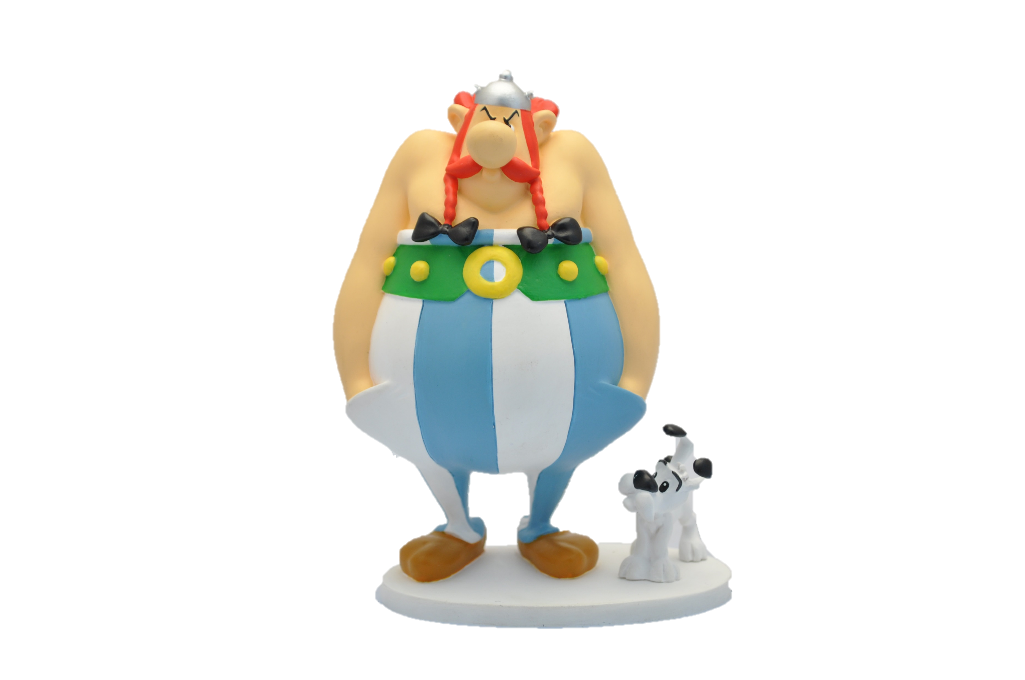
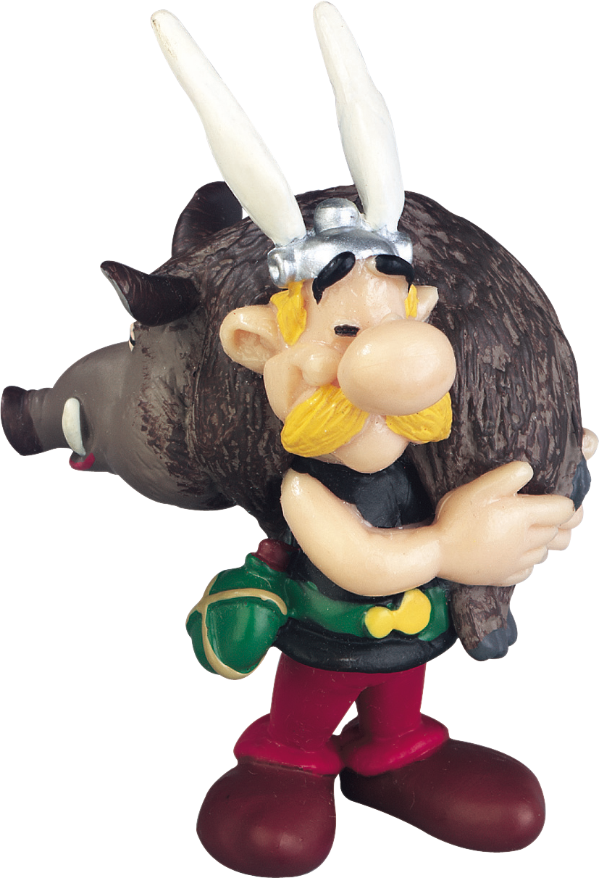
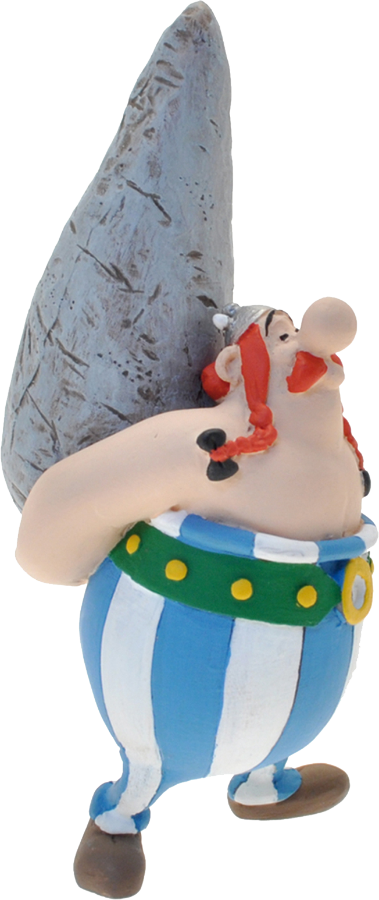
PRODUCT OFFER (TBD)
6 cm
15 cm
10 cm
Limited Edition – 49,99€
The Game
2 mini figures (Asterix & Obelix)
Collector Edition – 79,99€
The Game
All-in-one Exclusive Resin Obelix + Idefix Figure

Slide 4


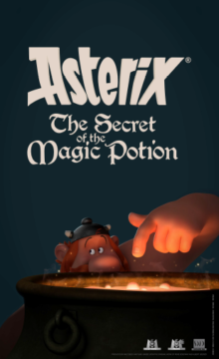

THE ASTERIX LICENCE
9 Cartoons
4 Movies
370 millions Comics
PARC ASTERIX
+2 millions visitors (2017)

Slide 5
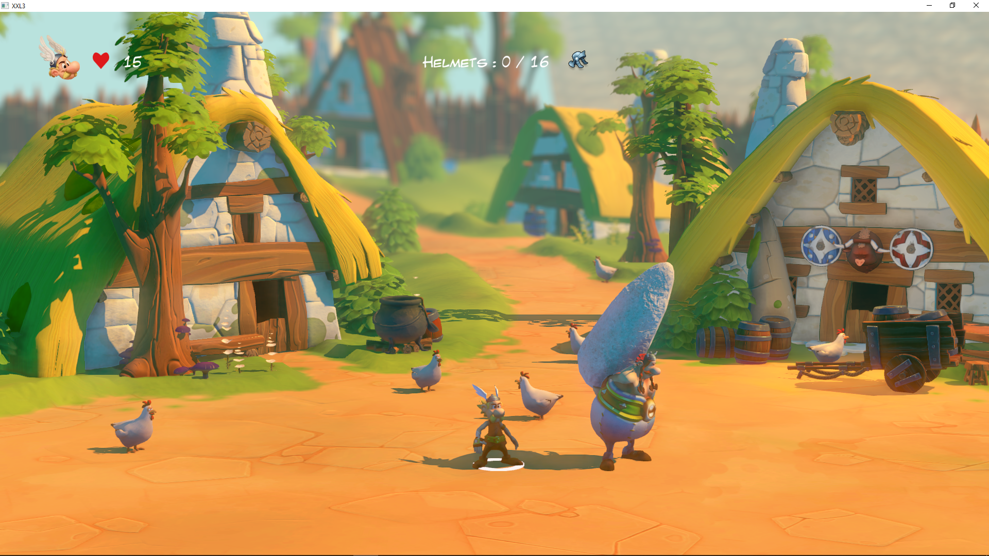
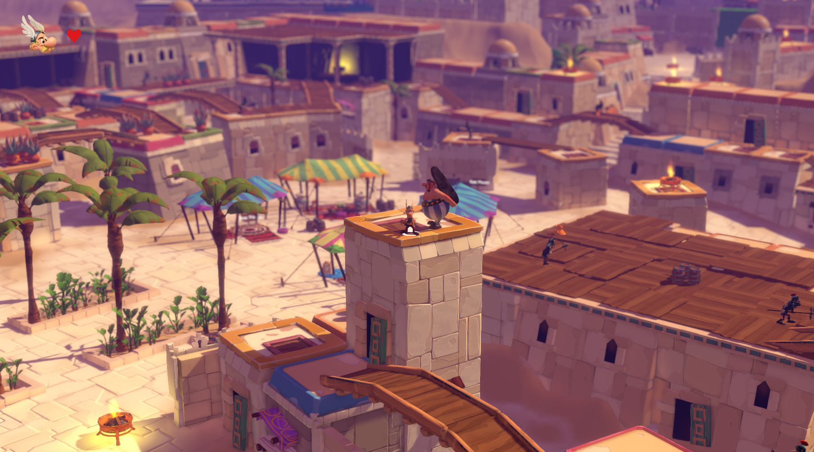
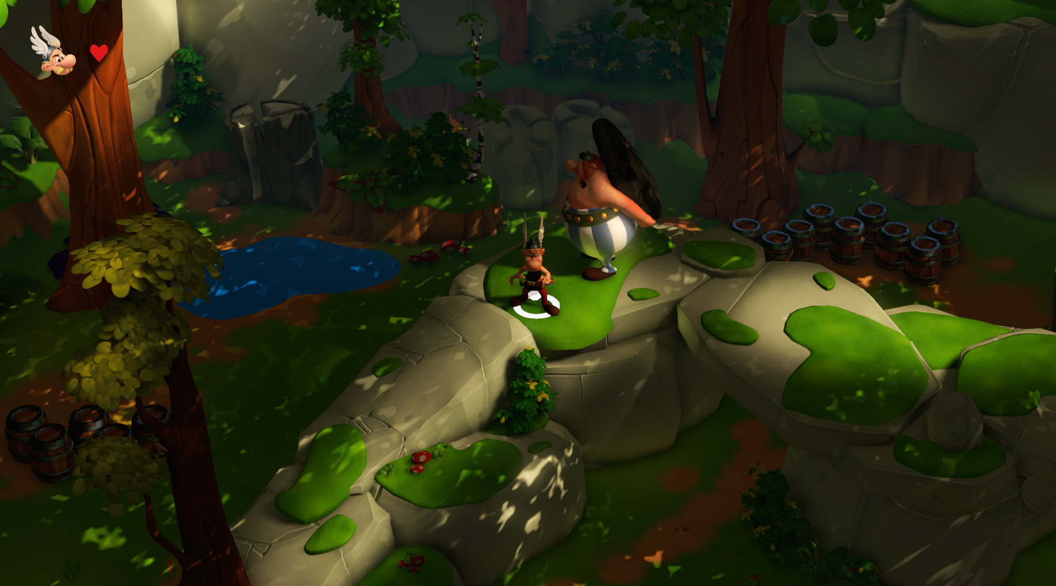
An Original Story…
Travel with Asterix and Obelix and gather all crystal menhir shards to save Islandia!
Islandia is in danger ! Its citizens need the Cristal Menhir to rescue the island. This one was back in the day, entrusted to Getafix. But the Cristal is incomplete and our heroes will need to brave all the dangers to find all the missing shards and bring back the artefact in the Cristal Cavern. A new Astérix, Obelix and Dogmatix’s Adventure with a bunch of legionnaires, a spoon of slaps and a pinch of Julius Caesar. This quest will rush our friends in burning desert of Middle East, until the iced area of Islandie

Slide 6




…Full of Movie References
The Game will subtly integrate other references of beloved movies which have scored the box-office, but by conserving the typical Asterix humour!

Slide 7
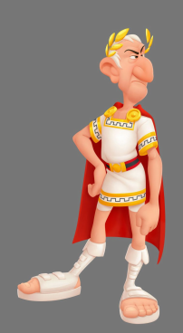
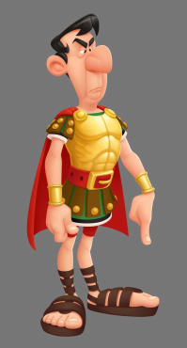
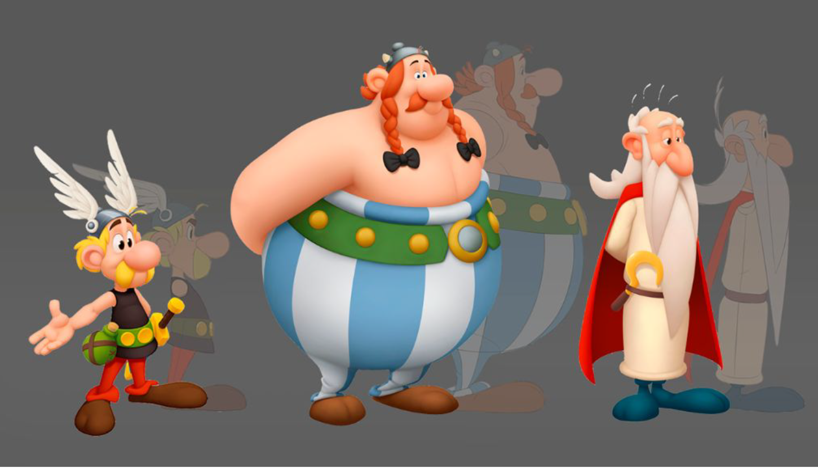
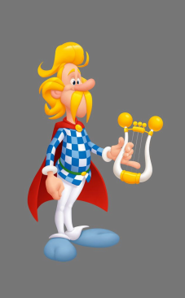
ARTISTIC DIRECTION
The Artistic Direction is getting closer to the Asterix Movie

Slide 8
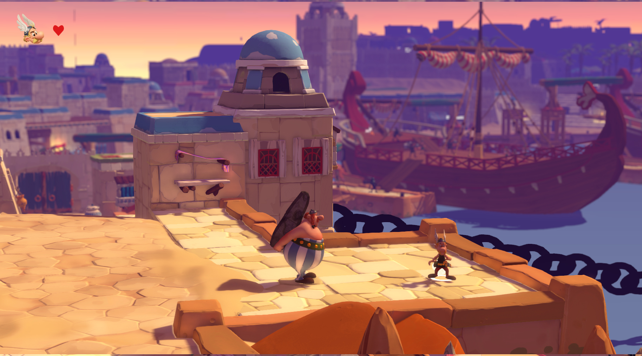
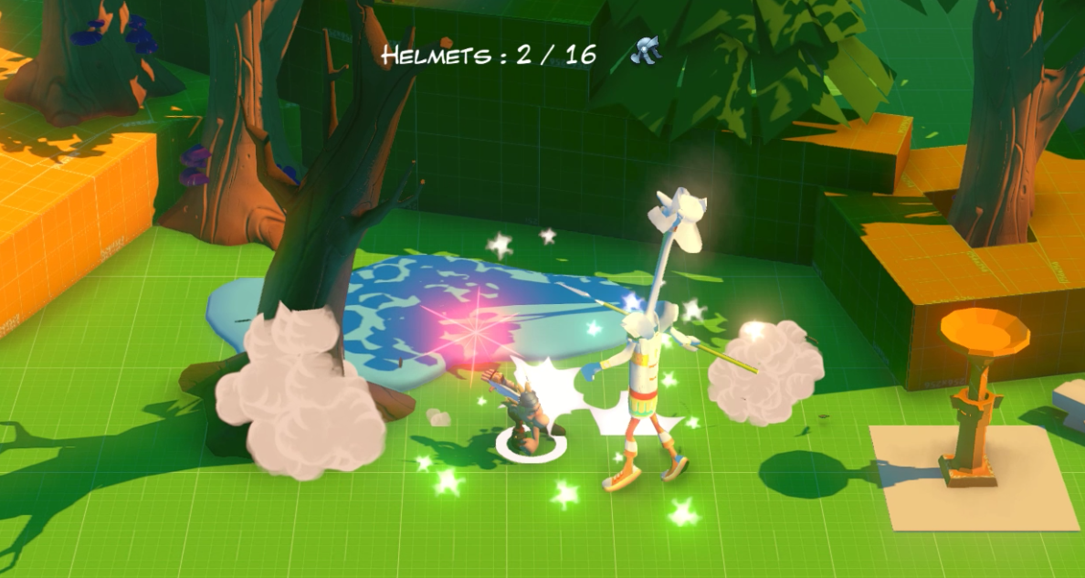
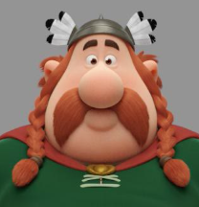
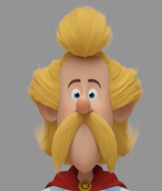
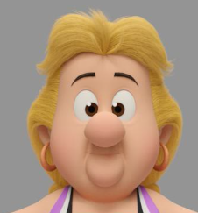
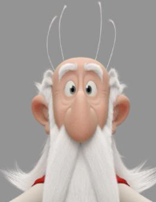
GAME CONTENT
Play for the first time in local cooperation mode!
Travel Across Europe and dozen of levels!
Emblematic comic characters + exclusive Characters!
Thousands of Roman Soldiers to smash!

Slide 9

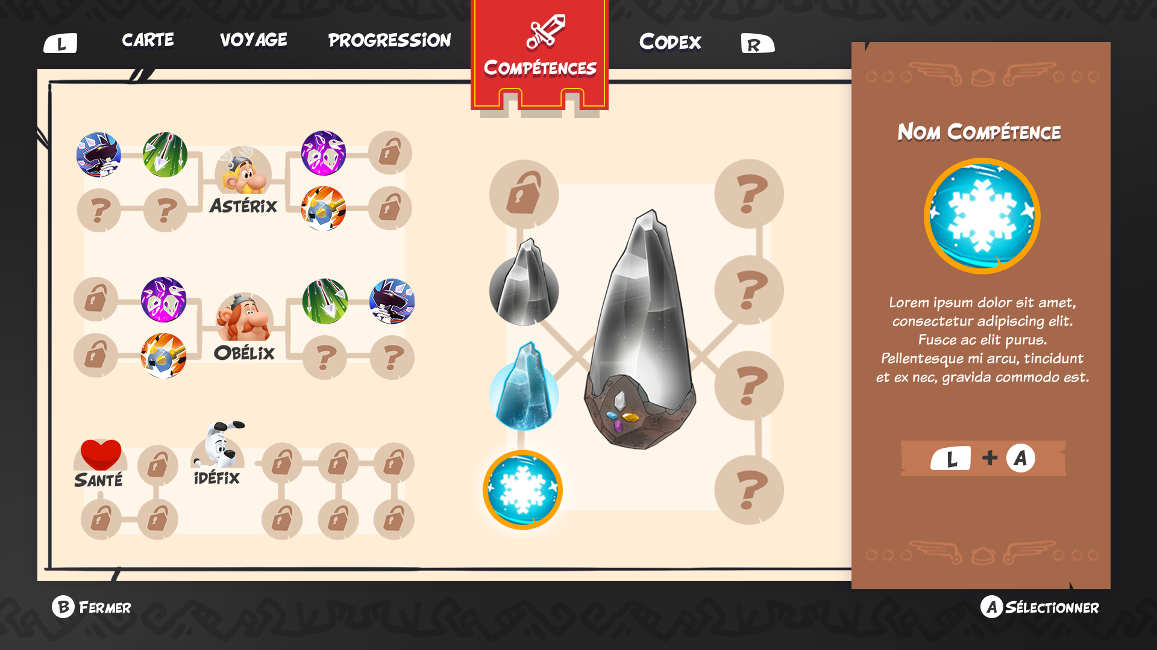



FEATURES: The Crystal Menhir
Our heroes have to collect the missing shards of the Cristal Menhir in order to bring back its properties: Ice, Fire and Magnetic. The player will discover them as he progresses. Each Menhir property will have different effects:
Without Shard:
By hitting the menhir on the floor, Obélix trigger a shock wave which breaks or projects objects backward. Romans enemies are blown and the closers are stunned
Ice Shard
A cold snap froze the water and items in the action area. For few seconds, enemies are frozen and idling, or sometimes immobilized
Fire Shard :
Ignite your environment: items and romans will react differently in front of the flames, i twill be your job to adapt your actions according to the kind of enemy
Magnetic Shard
Attract the metalic objects or even the enemies towards you thanks to the magnetic power of the menhir

Slide 10





GAME PILLARS
Battle
Cross over a plenty of roman camps, through the various countries
Exploration
Explore the replayable areas to find the secondary quests, the secret passages and learn about the story of the place
Puzzle
Use the Cristal Menhir power and its synergie on the environment .
Collect
Break the fragile objects, hunt the boars, find bonus, seek the easter eggs, and find out the hidden licence glimpse

Slide 11
TARGETS
PRIMARY TARGET
SECONDARY TARGET
- 8-13 years old kids
- Parents wanting to share moments with their kids (and want them to discover a cartoon from their « generation »)
People who likes adventure and cooperation games (25-40 years old)
Gamers keen on the XXL Franchise, bringing back memories
THE PERFECT FAMILY GAME
*Console owners

Slide 12

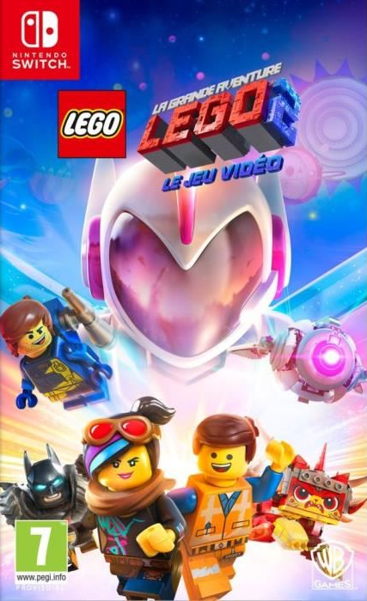

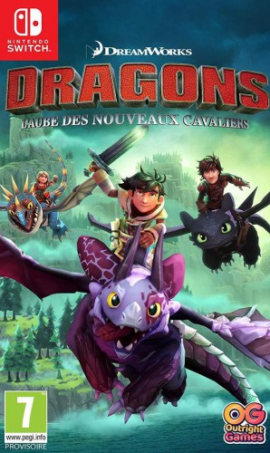
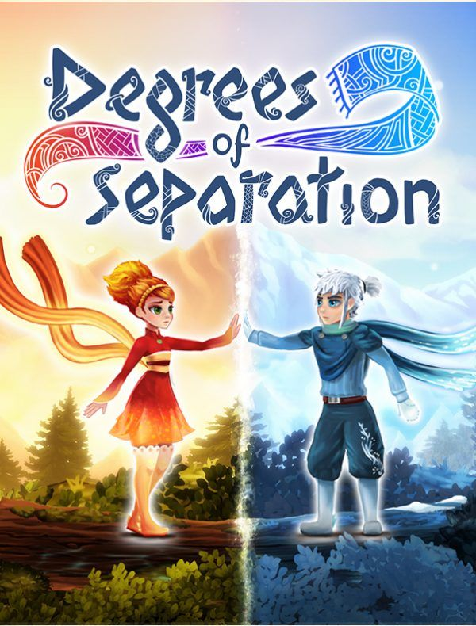
2019 COOP GAMES
Release date: 27th of March
Release date: 29th of March
Release date: 14th February
Release date: 1st February
PRICE: 39,99€
PRICE: 64,99€
PRICE: tbd
PRICE: 39,99€

Slide 13

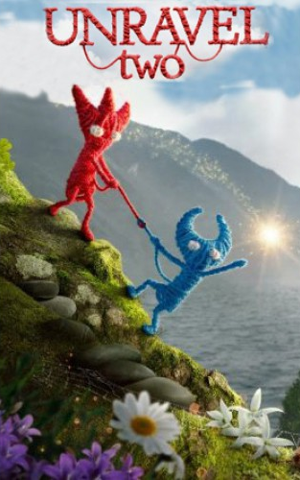

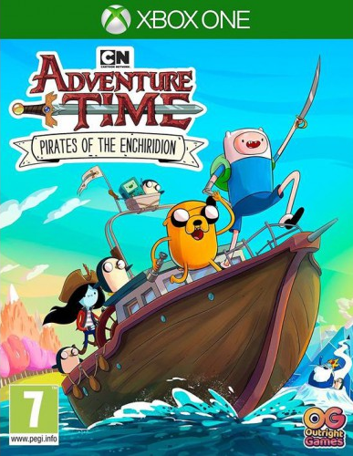



2018 COOP GAMES
Release date: 4th may
Release date: 4th may
Release date: 13th July
Release date: 20th July
PRICE: 64,99€
PRICE: 19,99€
PRICE: 39,99€
PRICE: 39,99€

Slide 14
MAGIC POTION EFFECTS
Strenghts
Opportunities
- Cooperation Mode
- Unique Gameplay (Crystal Menhir), Story and iconic funny characters
- Strong graphic enhancement compare to the previous game
- References
- Open window regarding family/party games
- New comic book releasing End of 2019
- Asterix 60th anniversary
- A game planned and fitted for the christmas period and retail levers

Slide 15
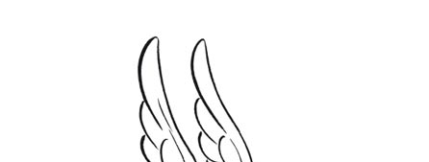

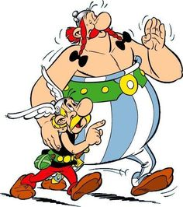


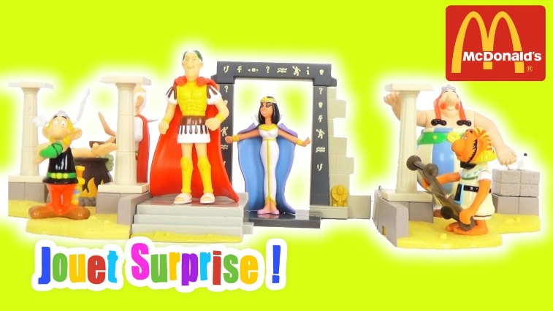
Marketing Actions Direction (TBD)
A VIDEO GAME
In Your Meal
Key product of the Asterix 60th birthday campaign
Cooperation-based marketing operations
Family-targeted marketing operations

Slide 16

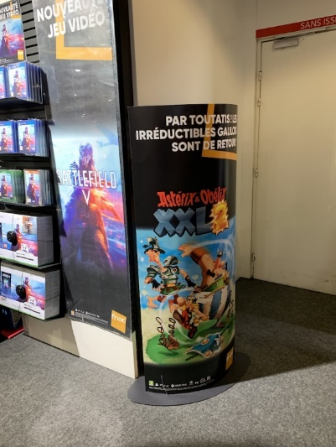
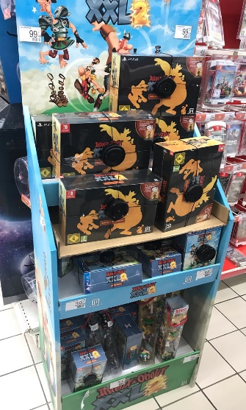
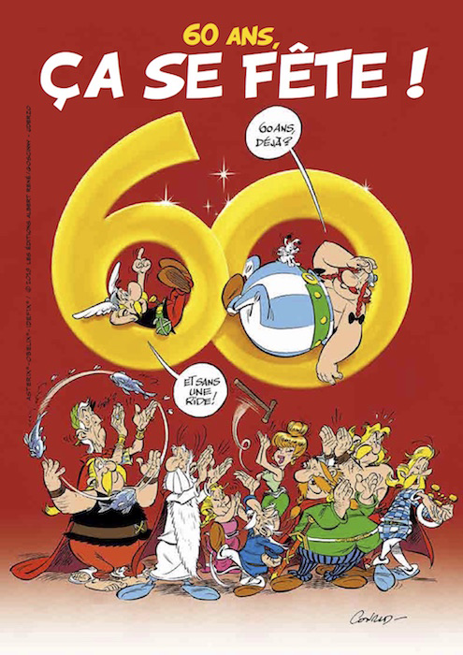
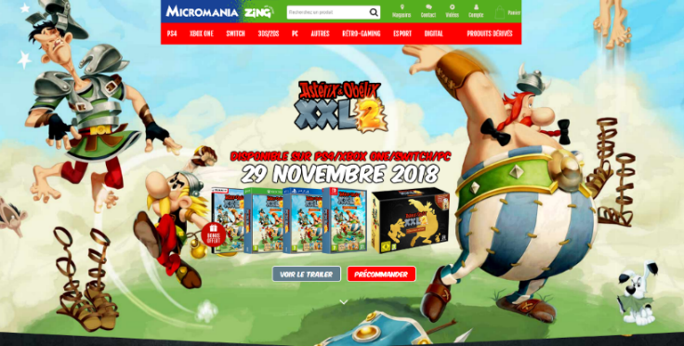

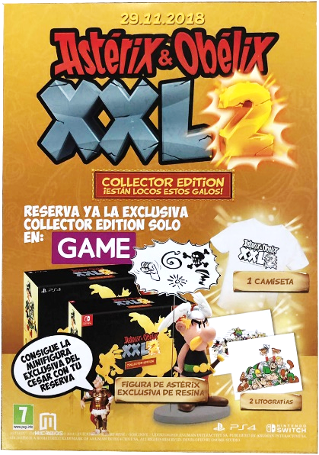
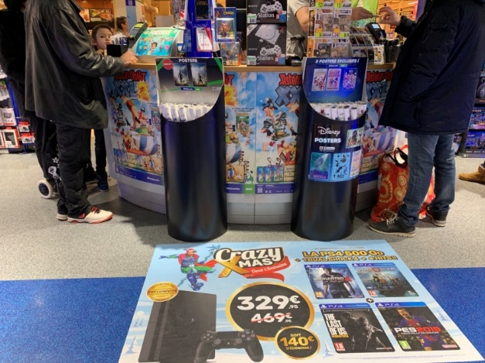
Retail Actions Direction (TBD)
Official comic book retail partnership
Activating stronger incentives for pre-orders…
…and a stronger in-store presence

Slide 17
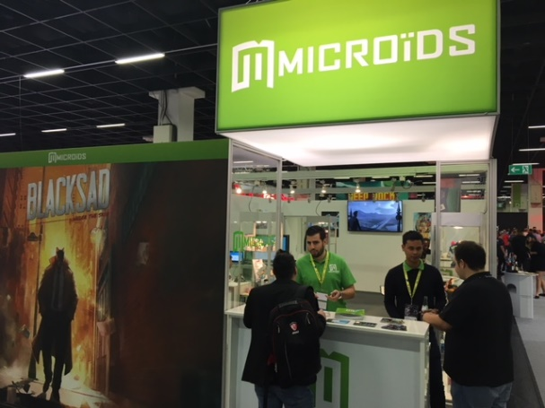




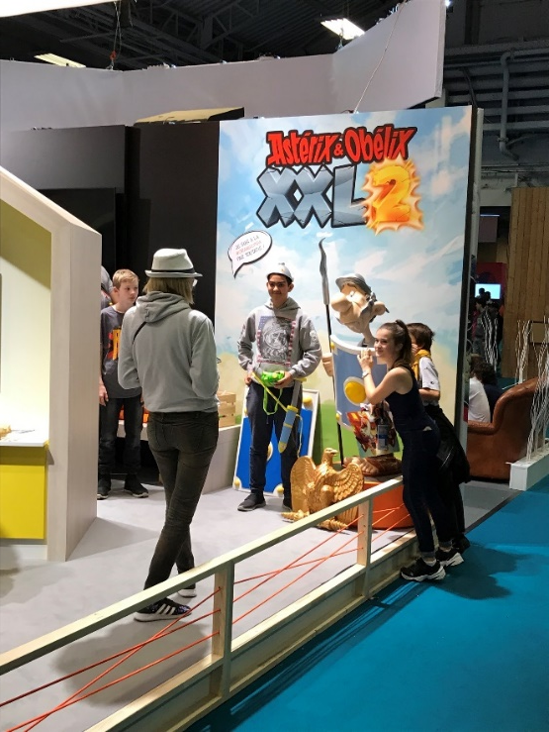
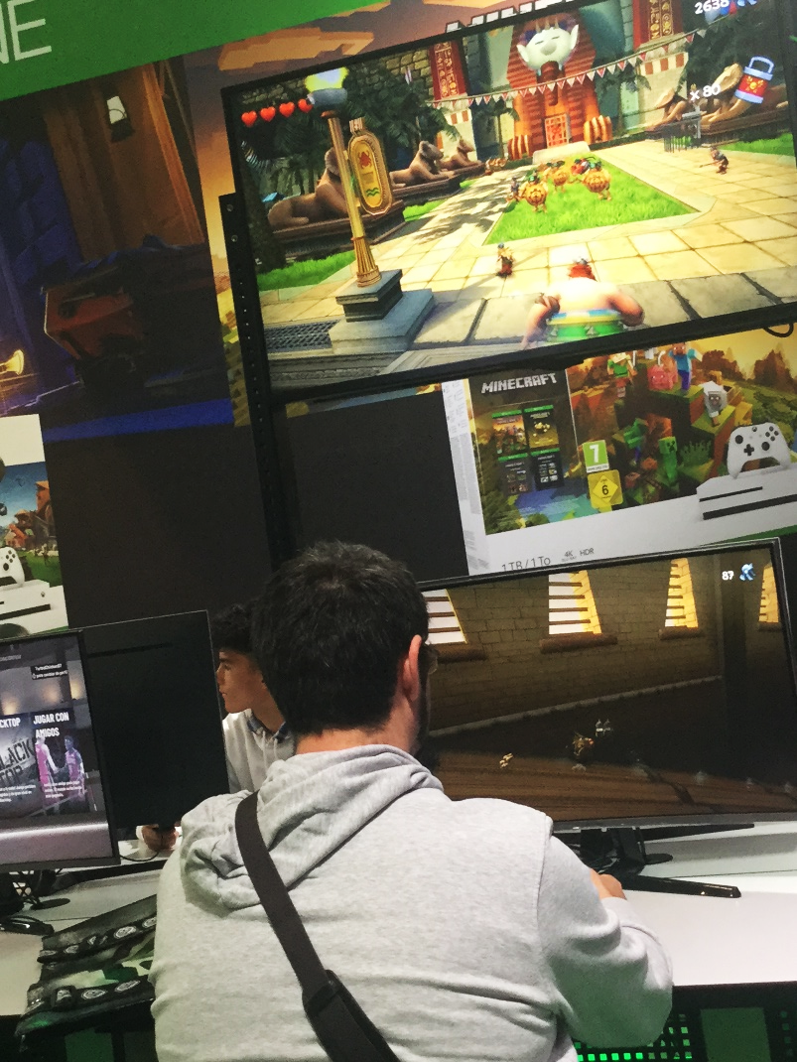
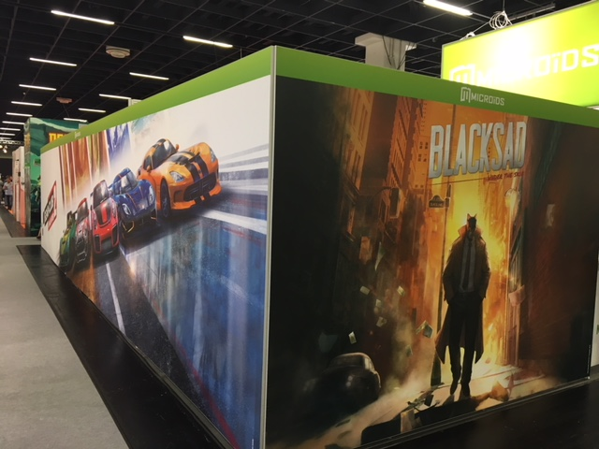
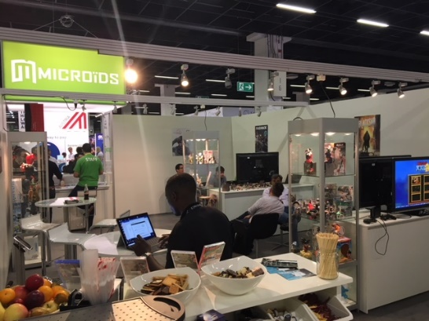
MARKETING EVENTS
+ 136 000
visitors
+ 370 000 visitors
+ 350 000 visitors

Slide 18
PR PLAN

Slide 19
COMMUNICATION STRATEGY
Activities:
Focus on top outlets and influencers
High impact awarness campaign targeting kids but not forgetting to reassure the parents of the overall value of the game
Leverage key licence events to drive awareness of the game (Anniversary…)
Emphasize on this brand new adventure of the 2 famous Gauls
Create specific content with youtubers and Twitchers based on coop mode
Approach:
Position Asterix & Obelix XXL3 as Family game of the year
Focus on the Family : All messaging to tie back to family gaming experience
Provide ongoing engagement to deliver fun and sustained interest during the launch campaign

Slide 20
TARGETED MEDIA
SPECIALIZED PRESS
Pre-launch and launch coverage
Both in print and digital
Fans of the license who already reviewed the XXL2
Curious about the license and the totally new scenario and game
MAINSTREAM PRESS
Pre-launch and launch coverage
Kids Magazine – Movie Magazine – Comic book
Lifestyle – Feminine – Entertainment
Big print magazines – Newspaper – Business
Good to target old and new players
Fans of the license and its reputation
BLOG
Launch coverage
Lifestyle blogs
Gaming blogs
Good visibility and big community likely to be interested
Always happy to review games and post pictures on social media
INFLUENCERS
Launch coverage
Famous gaming influencers – Family – Friends - Adventure specialists
Goal : Let’s Play and Stream to create visibility and show the good quality of the game
Fans of the game or gamers who want to play with friends or family
They want to have fun

Slide 21
KEY PR MESSAGES
New game with an exclusive scenario and a new concept : the Menhir has powers.
Fun and really good to play with friends or family.
A travel in many beautiful places : Gaulish village, Islandie, Crete, Rome… Different environments to discover.
Complete gameplay : Fighting, Collecting, Puzzles and Exploration.
References about pop-culture movies.
Asterix and Obelix : The Crystal Menhir is an Action/Adventure game.
Asterix and Obelix is a famous strong universe, with well-known and beloved characters of the French pop-culture.
The game respects the humor and the universe of the comic, with an authentic content.
Important feature : Two players cooperation.

Slide 22
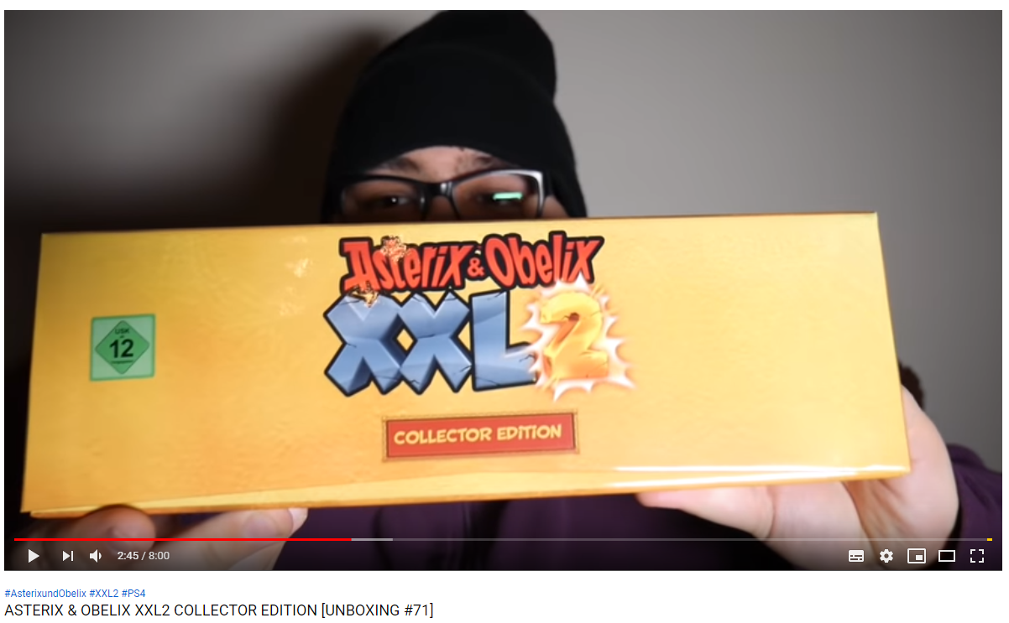
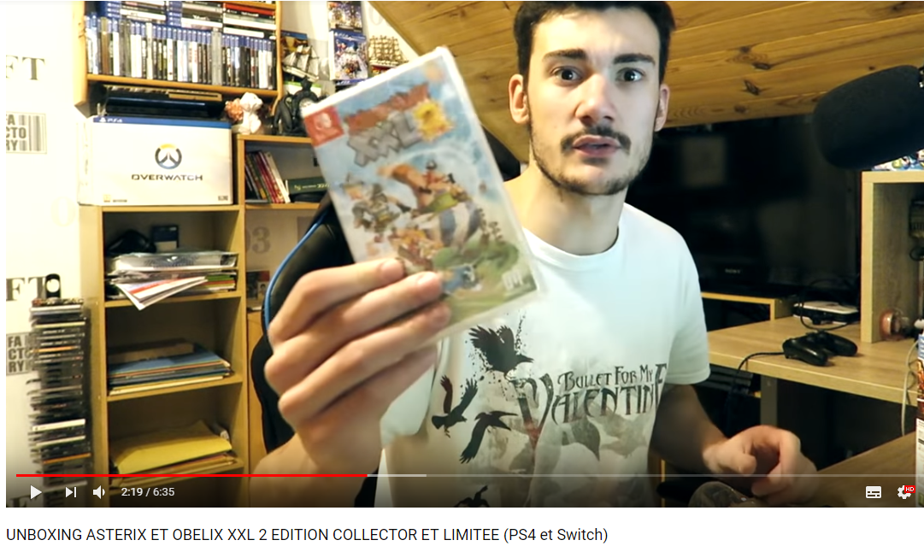
INFLUENCERS STRATEGY
ACTION
UNBOXING OF THE COLLECTOR EDITION
Let’s play video with (in priority) :
Gaming influencers
Family influencers
Young community influencers
Create specific content with influencers who have a strong fan base
Work with streamers to secure Day One live stream on Twitch/Youtube
Work with targeted influencers to ensure coverage on their channel and/or social media accounts
Ensure videos and photos showing the Collector Edition
Share this content on our social media pages
Examples :
80K fans
12K fans

Slide 23
DEDICATED PRESS KIT
IDEA
GOAL
Create a dedicated press kit for the media.
With an original press folder containing information and details from the game.
Some goodies, linked to the game, the universe and the characters.
Give more information to the media concerning the product.
Create visibility on social media (for the game, its universe, the studio and the editor).
Motivate media to create more coverage around the game.
Accompany the articles and the posts.

Slide 24
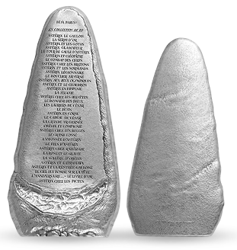

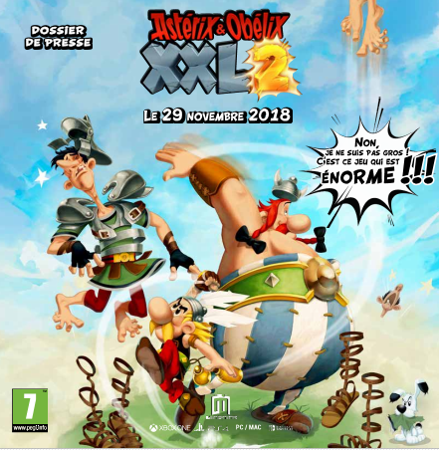
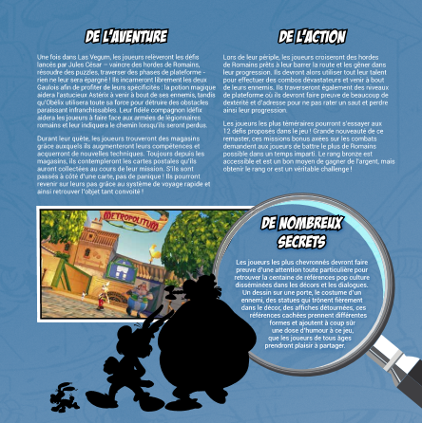
DEDICATED PRESS KIT
PRESS FOLDER IDEA 1
A press folder in the shape of a Menhir.
4 pages of information regarding the game.
Content : Information on the game, on the company, screens, character presentation, PR contacts, etc…
PRESS FOLDER REALIZED FOR XXL2 :

Slide 25
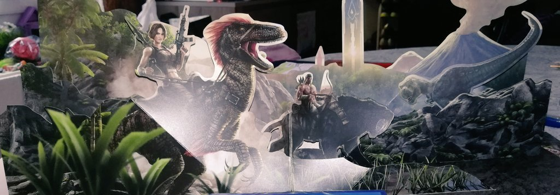
DEDICATED PRESS KIT
PRESS FOLDER IDEA 2
EXAMPLE WITH THE GAME “ARK” :
An original press folder (Cut out images that unfold when the document opens)
1 leaflet to communicate the information regarding the game.
The form will delight the kids.
Content : Information on the game, PR contacts…
PRESS FOLDER REALIZED FOR XXL2 :

Slide 26
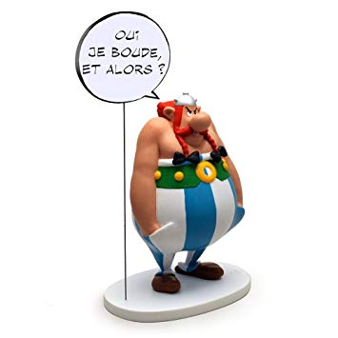

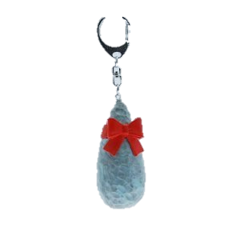





DEDICATED PRESS KIT
GOODIES IDEAS
Gourd
Figurine
Pins
T-shirt
Key ring
Map of the trip in the game
OTHER IDEA : https://youtu.be/_Z13G3RcdvI

Slide 27
EVENT
GAMESCOM & PARIS GAMES WEEK
Organize preview events during both shows :
> Hands-on event
> Lot-of international media present
> Good visibility
> Possibility to show a special build to the media
A dedicated press room decorated in the universe of the game (the famous village of Asterix, figurine, plush,…)
A guest to answer interviews and possible questions during the demo
Animation : Photobooth with dedicated accessories to offer a memory and motivate to publish on social media (creation of a #)

Slide 28

EVENT
PARC ASTERIX
30 years of the park in 2019
A new attraction called « Attention Menhir »
> Perfect with the subject of the game
IDEA 1 : Make a video with an influencer directly in the park (answer questions on the game during an attraction, try to play the game in an other, etc…)
IDEA 2 : Create an action to mix the game and the new attraction « Attention Menhir », as the principal subject is the same.
Attention Menhir is a 4D movie with surprising special effects.

Slide 29




EVENT
LOCAL EVENT
IDEA : Present the game to our media and their children during one day, with hands-on and animation.
Possibility to play the game
Banquet meal (chicken, wild boar, fake magic potion,…)
Decoration : barrels, greenery, lyre, figurines,...
Photobooth + Accessories
Goodies at the end of the event

Slide 30



EVENT
DEDICATED ANIMATION
Example : OSKUNK (or Arttitude)
Work with an artist to offer a unique and fun image to the game.
Create a direct video or a direct creation of the item during the local event.
IDEA : Create an unique item dedicated on the game.

Slide 31

EVENT
DEDICATED ANIMATION
A new album will be released the 24th of October 2019. : « La fille de Vercingétorix ».
IDEA : Organize an action between this release and the release of the game ?

